Slide 1

Intro to Soldering
Villanova IEEE

Slide 2
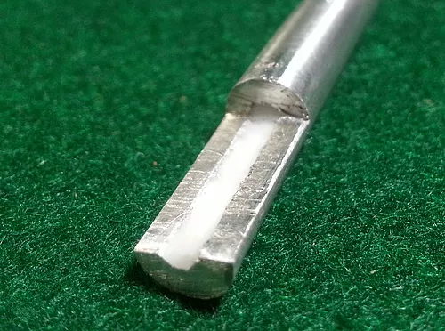
What is solder?
Previously lead-based
Flux core vs. solid wire
Used as a bonding agent between electrical components and PCB pads
Notes:
Flux helps prevent oxidation and can act as a cleaning agent when oil, dirt, etc. are present. Also increases reflow and assists in making stronger joints.

Slide 3
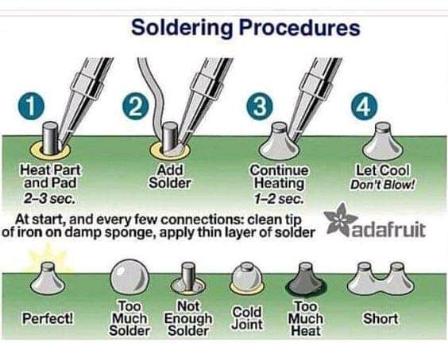
How to Solder
**Turn Temperature Gauge to ~400 ⁰C

Slide 4
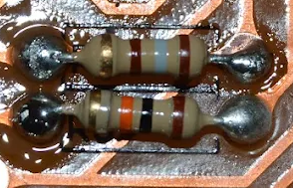
Notes:
Top right pad lacks solder
Bottom right is semi-dull. Shiny finish demonstrates good solidification/cooling

Slide 5
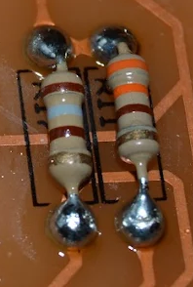
Notes:
Ask if we think this is a good or poor representation of soldering?
It may seem poor as the joints look like balls, but that is because we’re soldering on the same side of the board as the component, and there is much less lead to build up the tear drop shape. There is still some solder moving up towards the component which is good.

Slide 6
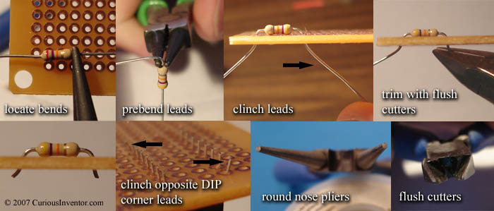
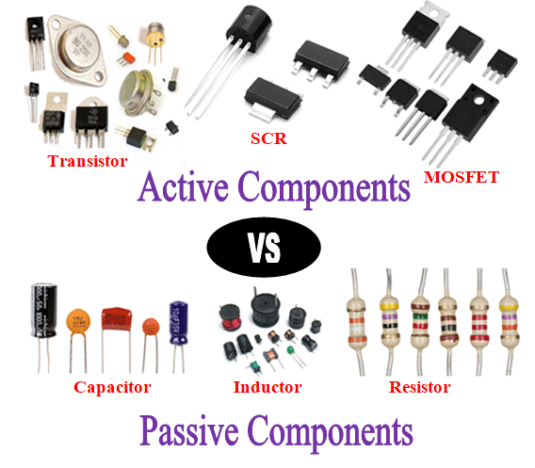
Trimming Components
Passive Components
Fine to solder and trim
Active Components
Should be trimmed before soldering
Trim to the height of your capacitors
If you trim too low, reflow the solder by applying heat
Notes:
“Should be trimmed before soldering” is demonstrated with a resistor and it’s good practice in general
Last bullet point means if the trimming cuts into any solder or you believe in any way you may have trimmed too close to the component, apply the iron and let the solder reflow and re-bond.

Slide 7
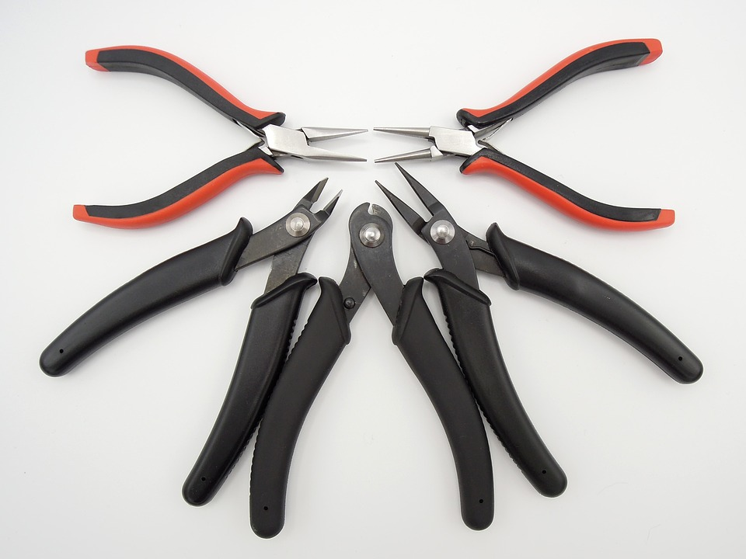
Cutter Types
Notes:
Flush cutters (leftmost all black) are better than shear cutters (middle) because the angle of the cutters determine where the force is transferred. If the flat part is pointed towards the board, most of the force will be applied to the trimmed lead and send it flying. With shear cutters, force is sent both ways and consequently some is sent into the component which can damage active components. This will be worse if flush cutters are used upside down.

Slide 8
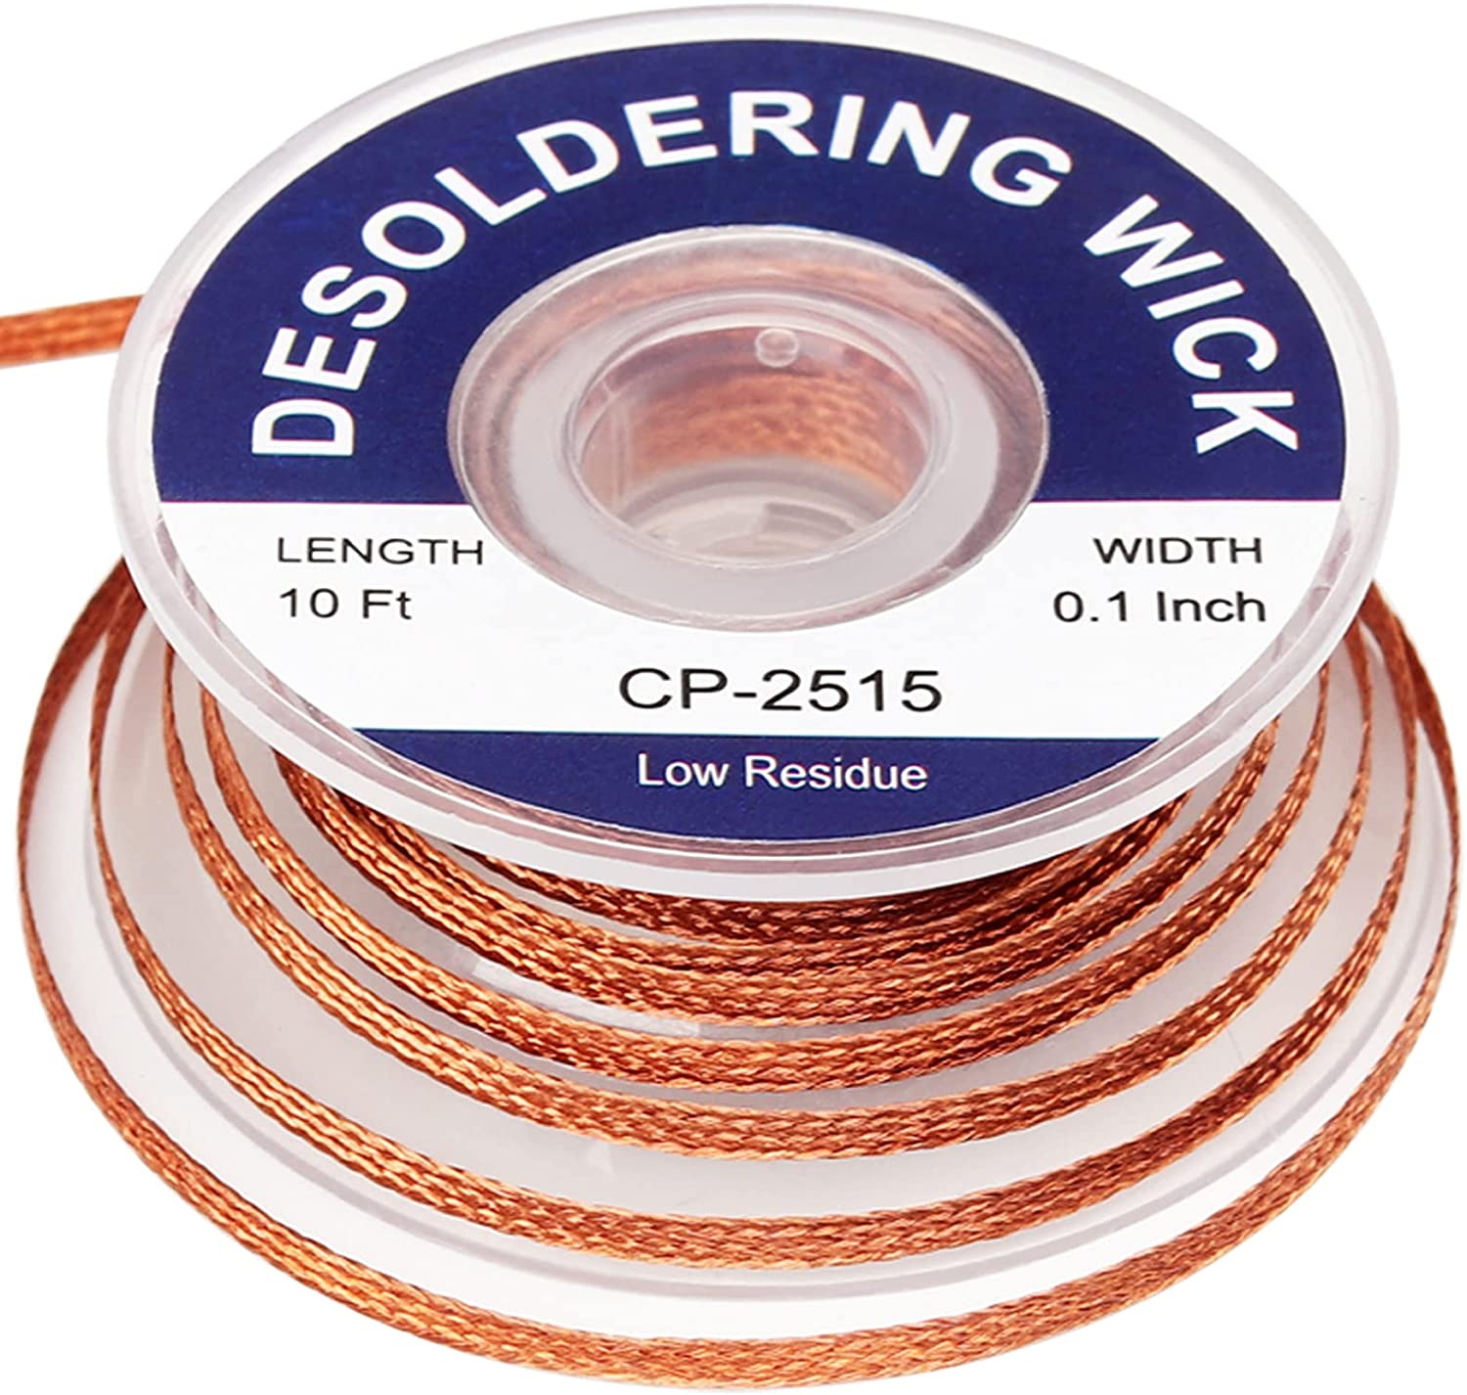
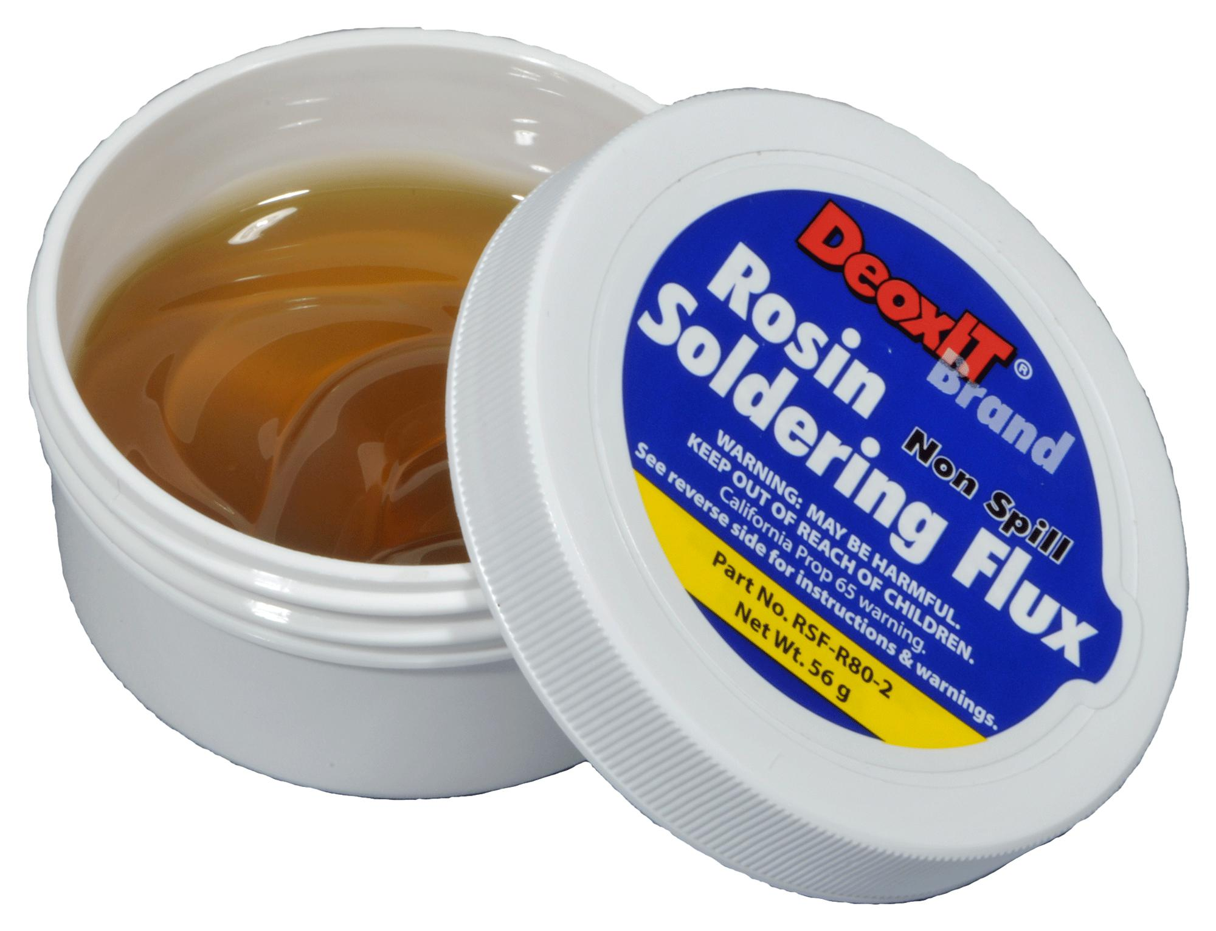
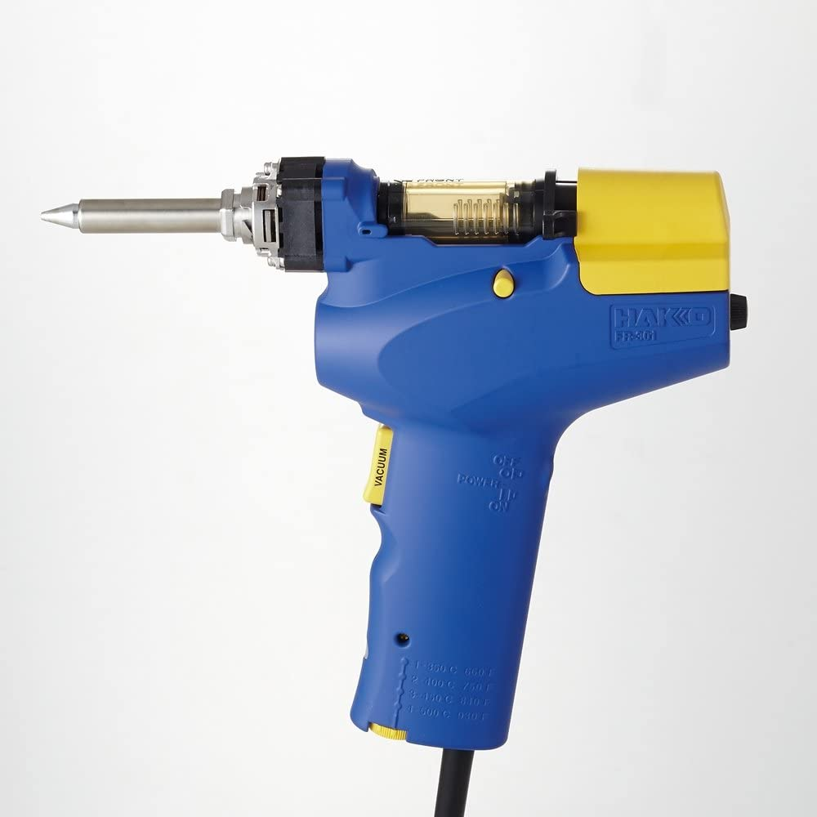
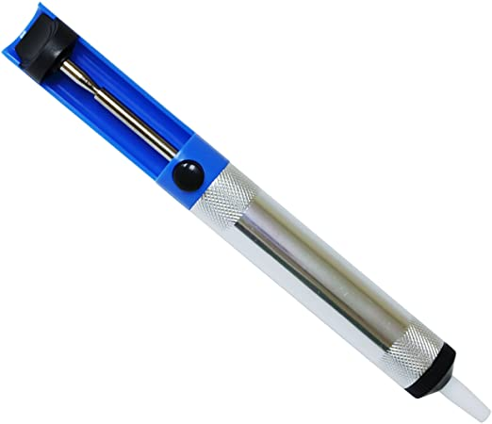
Desoldering
Solder sucker
Solder wick
Desoldering gun
Notes:
Solder sucker sucks up re-heated solder
A solder wick combined with flux will reflow solder away from the board and onto the wick, removing it.
A desoldering gun is a self-contained unit capable of reheating solder and vacuuming it from the board.

Slide 9
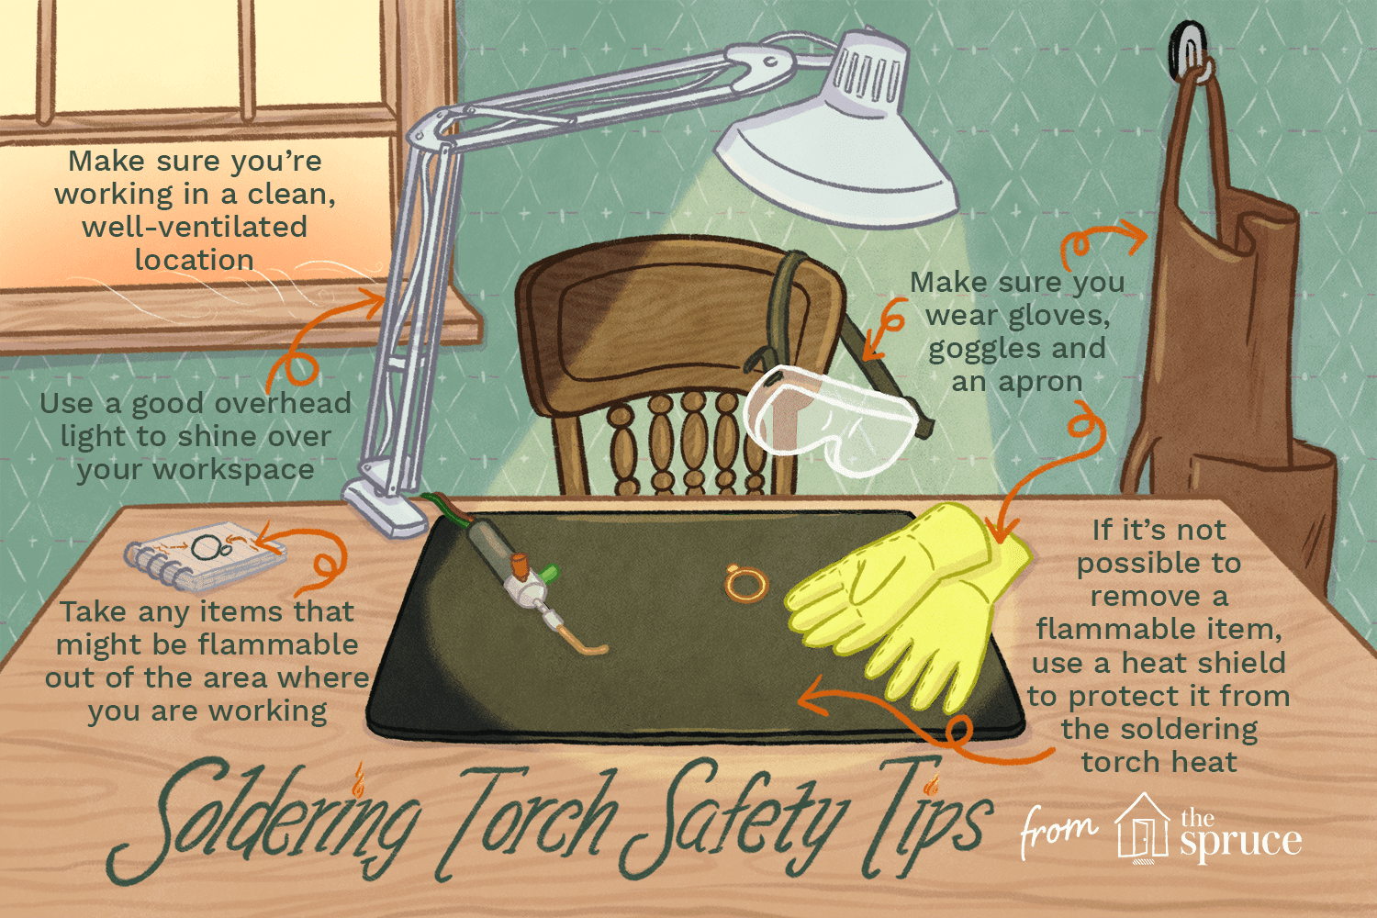
Safety Tips
Stay ventilated
Hold the soldering iron by the handle like a pencil
DO NOT try to catch the soldering iron if dropped. Move out of the way and then pick it up off the floor.
Goggles/glasses are encouraged.
Wash hands afterwards, especially before eating.

Slide 10
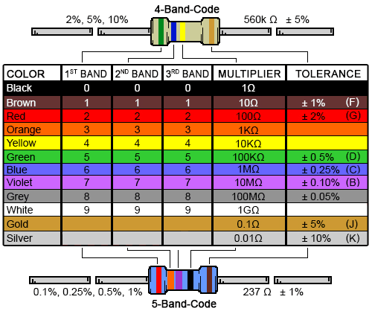

Slide 11
Christmas Tree Soldering Resistors
330: R6 → Orange, Orange, Black, Black
1k: R4 → Brown, Black, Black, Brown
10k: R1/R3/R5/R7 → Brown, Black, Black, Red
2k: R2 → Red, Black, Black, Brown

